Slide 1

Email-based Data Exfiltration Through Insider Threat Detection
MINOR PROJECT
Faculty Advisor : Mr. Dharmesh Dave
Disha Sharma
240103002014
9th May 2025

Slide 2
TABLE OF CONTENTS
SR. NO. | TOPIC | DESCRIPTION
1. | Introduction | Motivation and Scope of the Project
2. | Theoretical Background | Research Findings and Comparative Analysis
3. | Proposed Model | Problem Statement Revisited, Framework, Methodology
4. | Empirical Result Analysis | Experimental Setup, Evaluation Metrics, Testing/Implementation
5. | Conclusion | Future Scope. Progress Report, References

Slide 3
01 : INTRODUCTION

Slide 4
MOTIVATION
The Reasons :
Complicated IT Environment
Inadequate Security Measures
Lack of Employee Training and Awareness
Weak Enforcement Policies
The Numbers :
83% of Organizations reported at least one Insider Threat. (IBM)
67% of insiders are likely to email sensitive data externally. (Teramind)
36% organizations only had effective access control solutions in place. (IBM)
54% of insiders already have credentialed access. (StationX)
44% insiders use applications that can leak data eg Email (StationX)

Slide 5
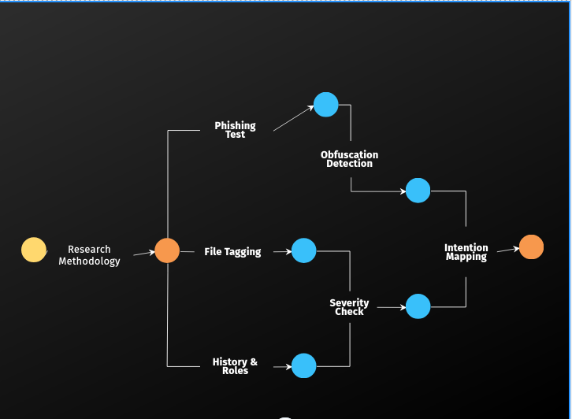
SCOPE OF THE PROJECT
Figure 01 : A PERT chart created to organize the scope and roadmap of the project.

Slide 6
02 : THEORETICAL BACKGROUND

Slide 7
RESEARCH FINDINGS
Detection Approach | Signature Based VS Anomaly Based
Suitability | Static Analysis VS Behavioral Analysis
Customization & Extensibility | Small-scale VS Large-scale
Alerting & Logging | CLI VS GUI
Table 01 : Findings From Literature Review

Slide 8
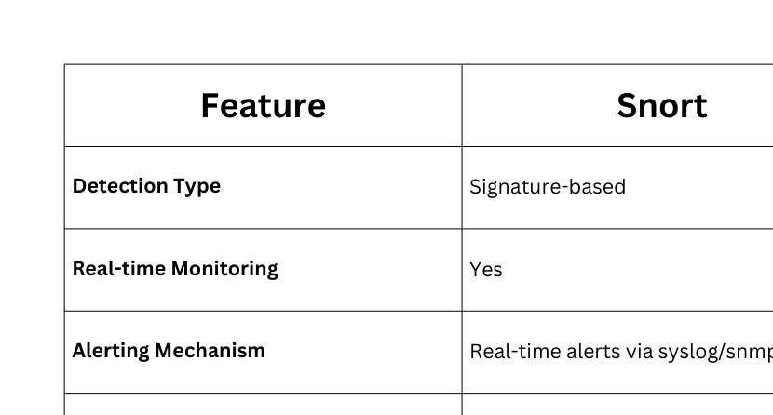
COMPARATIVE ANALYSIS
Table 02 : Comparative Analysis of Existing Tools

Slide 9
03 : PROPOSED MODEL

Slide 10
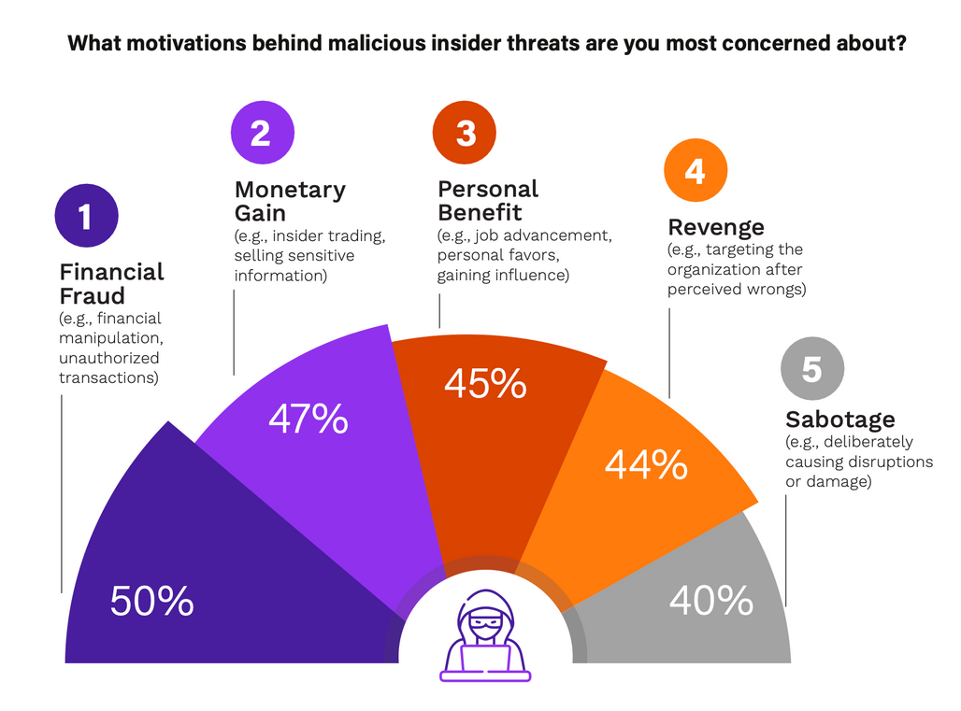
PROBLEM STATEMENT
This project aims to develop a custom, real time threat detection system tailored for small and medium sized organizations, enhancing security visibility against email-based insider threads.
Keywords : Email Communication, Intent Classification, Rule-based model, Real-time alerting
Figure 02 : Motivation Behind Malicious Attackers
“Understanding the Shifting Perceptions of Insider Threats over External Cyber Attacks.” Securonix, 25 Jan. 2024, www.securonix.com/blog/shifting-perceptions-of-insider-threats-vs-external-cyber-attacks/.

Slide 11
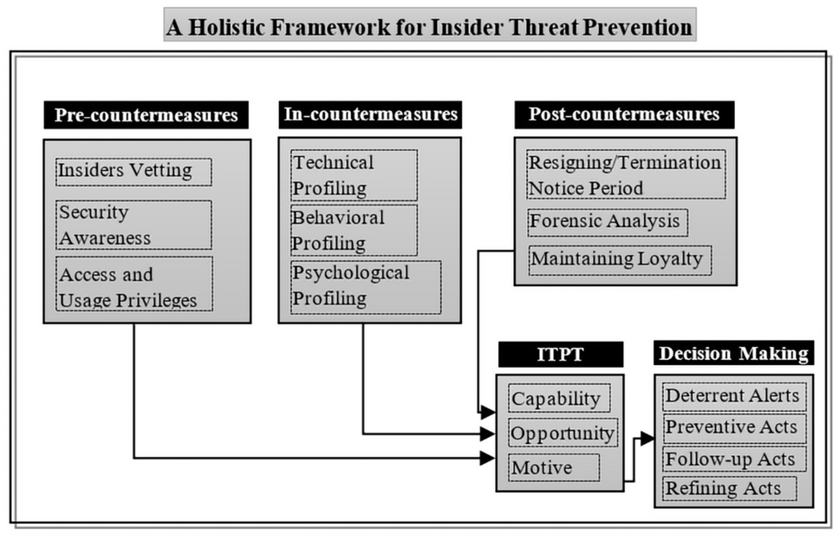
FRAMEWORK
Email Monitoring Schedule
Threat Classification
Gmail API, Email Headers, Drafts, Forwarded Emails, Signature Attachments
Careless Insider, Malicious Insider, Normal Communication, Severity - High, Medium, Low
Content & Attachment Analyzer
Alert & Logging System
Static rules engine, File tagging and hashing module, NLP Engine
CLI, Centralized logging, Real-time
Dashboard/Interface
Behavioral Analysis
Incident History, User Activity, Real-time Alerts and Logs
Frequency, User Roles, User History, Repeated Actions
Figure 03 : System Model
Alsowail, Rakan A., and Taher Al-Shehari. “A Multi-Tiered Framework for Insider Threat Prevention.” MDPI, Multidisciplinary Digital Publishing Institute, 22 Apr. 2021, www.mdpi.com/2079-9292/10/9/1005.

Slide 12
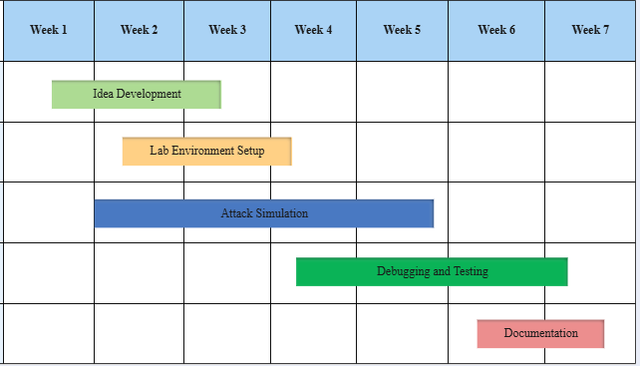
METHODOLOGY
Email Monitoring
Rule-Based
File Tagging
Content Matching
Classification
Sender/Recipient Analysis
Timestamp
Subject
Email Body Attachments
Static Detection
Phishing Attempts
Misaddressed Emails
Unauthorized File Uploads
Confidentiality
Cross References
Access Control
Signature Protection
Fuzzy Hashing
Hash Database
NLP Based
Intention - Accidental or Intentional
Severity - High, Medium, Low
User Behavior Analysis
Figure 04 : Gantt Chart

Slide 13
04 : EMPIRICAL RESULT ANALYSIS

Slide 14
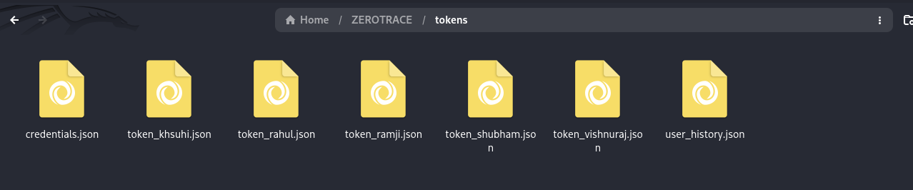
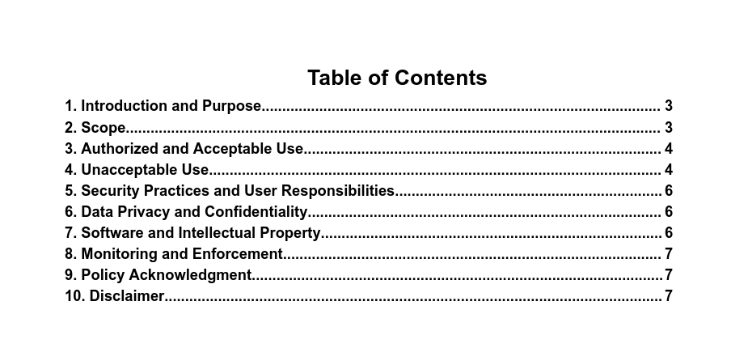
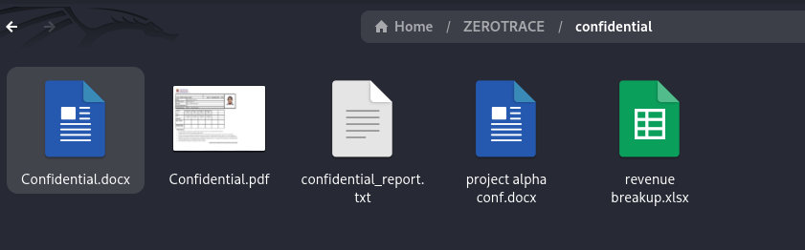
EXPERIMENTAL SETUP
Figure 05 : Authorizing Users
Figure 06 : Zerotrace Acceptable Usage Policy
Figure 07 : Confidential Attachments

Slide 15
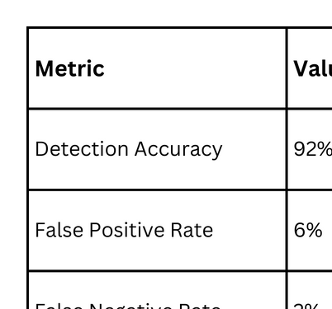
EVALUATION METRICS
Table 03 : Evaluation Criteria and Results

Slide 16
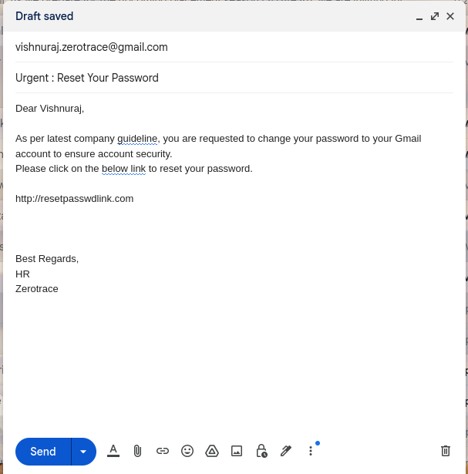
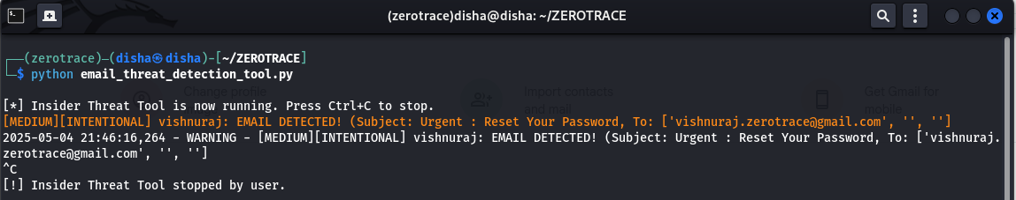
EDGE CASE #1
Figure 09: Alert Detected
Why? - To detect accidental of incidental phishing attempts. External Email, Internal Forwards (repeated), Obfuscation, Encoding
Figure 08 : Phishing Email

Slide 17
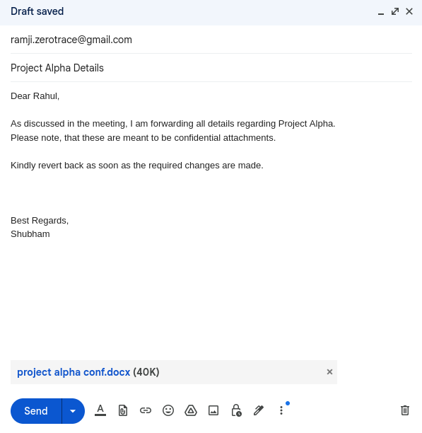
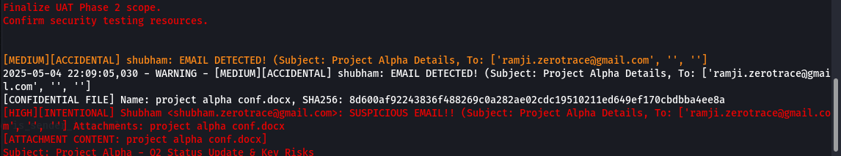
EDGE CASE #2
Figure 11: Alert Detected
Why? - To detect misaddressed emails (accidental), personal email uploads (intentional), Confidential Attachments, ZIP Attachments
Figure 10 : Misaddressed Email

Slide 18

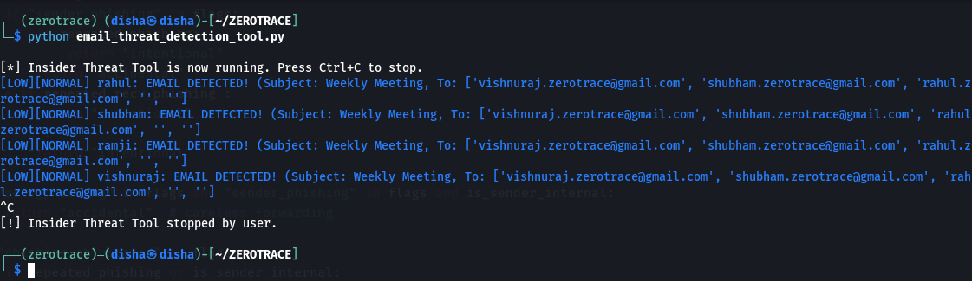
EDGE CASE #3
Figure 13: Alert Detected
Why? - To distinguish normal emails from suspicious ones, False Positives
Figure 12 : Normal Email

Slide 19
FINAL THOUGHTS
Distinguishes and Classifies Intention
Customizable according to Organization’s needs
Lightweight and Resource Intensive

Slide 20
FUTURE SCOPE
Machine Learning Integration
Behavioral Baseline Profiling
Advanced NLP Techniques
Multi-Channel Monitoring
SIEM Integration
Macro Parsing
Automated Response

Slide 21
REFERENCES
Gelman, H., & Hastings, J. D. (2025). Scalable and Ethical Insider Threat Detection through Data Synthesis and Analysis by LLMs. arXiv preprint arXiv:2502.07045. https://arxiv.org/abs/2502.07045
Koli, L., Kalra, S., Thakur, R., Saifi, A., & Singh, K. (2025). AI-Driven IRM: Transforming Insider Risk Management with Adaptive Scoring and LLM-Based Threat Detection. arXiv preprint arXiv:2505.03796. https://arxiv.org/abs/2505.03796
Kantchelian, A., Neo, C., Stevens, R., Kim, H., Fu, Z., Momeni, S., ... & Poletto, M. (2024). Facade: High-Precision Insider Threat Detection Using Deep Contextual Anomaly Detection. arXiv preprint arXiv:2412.06700. https://arxiv.org/abs/2412.06700
Gayathri, R. G., et al. (2024). FedAT: Federated Adversarial Training for Distributed Insider Threat Detection. arXiv preprint arXiv:2409.13083. https://arxiv.org/abs/2409.13083
Zhang, Y., Wang, H., & Li, X. (2023). Insider Threat Detection Based on User Behavior Modeling and Anomaly Detection Algorithms. Applied Sciences, 9(19), 4018. https://www.mdpi.com/2076-3417/9/19/4018

Slide 22


Thank you!
PRESENTED BY : DISHA SHARMA
Enrollment Number : 240103002014
: https://www.linkedin.com/in/disha-sharma-0b9601218/
: https://github.com/Disha0611

